Slide 1
CHATBOT IN PYTHON
PRESENTED BY:
B RITHIK ROSHAN
912421104033

Slide 2
01
INTRODUCTION & PROBLEM DEFINITION
DESIGN THINKING
FUNCTIONALITY
USER INTERFACE ,NLP & INTEGRATION
TESTING & IMPROVEMENT
CONCLUSION
02
03
OVERVIEW
04
05
06

Slide 3
Introduction :
chatbot:
A chatbot is a computer program or an AI application designed to simulate human conversation through text or speech interactions.
Chatbots are created to engage with users in a natural and conversational manner, providing information, answering questions, and assisting with various tasks.

Slide 4
ABSTRACT:
Chatbot can be described as software that can chat with people using artificial intelligence. These software are used to perform tasks such as quickly responding to users, informing them, helping to purchase products and providing better service to customers. chatbots have become an integral part of various industries, from customer support to marketing and beyond. These intelligent conversational agents can automate tasks, answer questions, and engage with users in natural language. This presentation aims to provide an overview of building a chatbot using Python, one of the most popular programming languages for this purpose.

Slide 5
Problem definition:
The Chatbot is majorly used to solve the problems and makes it much more easier to resolve the problem experience by the user.
For a human, it is hard to construct a AI which was evolved properly and it is not able to attend or response for a problem or any other consequences in all time(24/7).
But for an AI Chatbot it is easy to receive or send the proper guidance or the answer that was the question depends on.Mostly the Chatbots are Predefined Question with a well defined Answers .

Slide 6
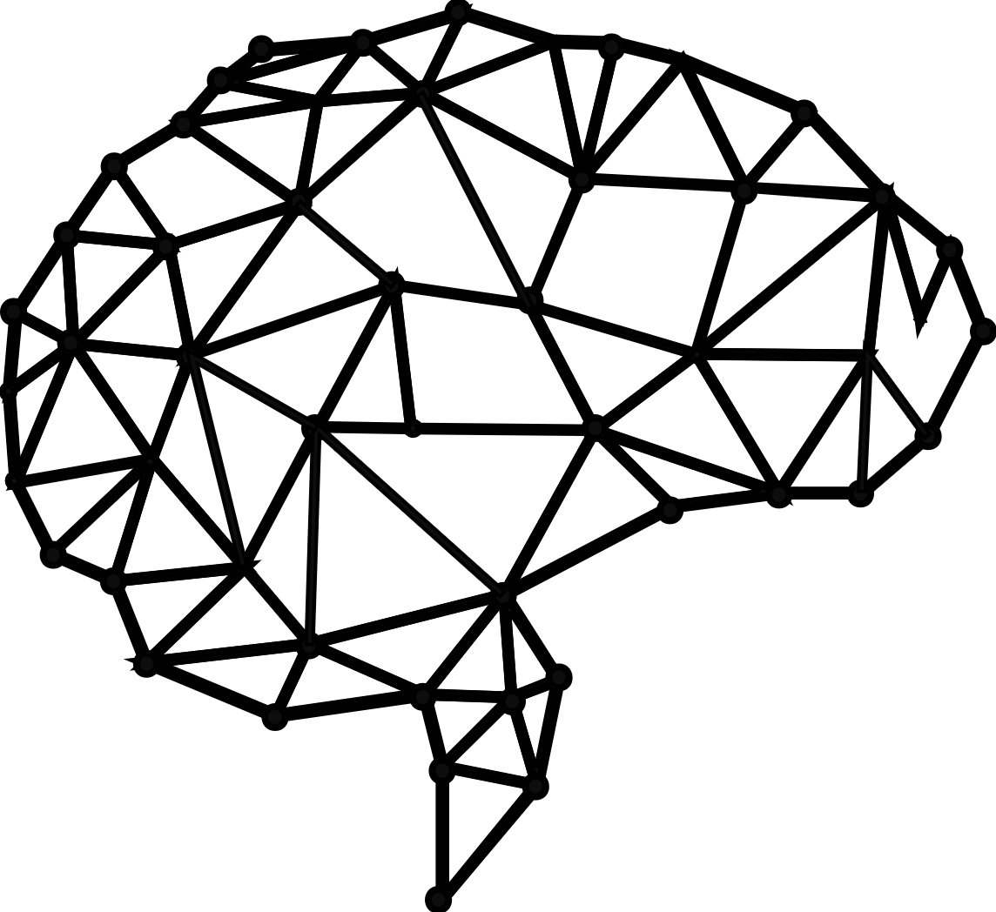
Design thinking:

Slide 7
Functionality:
Chatbots can provide instant assistance to customers, which can help reduce wait times and improve customer satisfaction.
In the future, chatbots may become even more sophisticated and be able to handle more complex customer service interactions.

Slide 8
Scopes :
Based On Ability : | Common Questions : | Proper Guidance :
Common Answer Proper Guidance Directing User | The Chatbots are used to answer the common questions that are pre defined and the way of responding the answers are also well defined previously with a data type. The questions that are defined witha codeword. | The Chatbot to guide the user with a proper way of answering the corresponding questions that was/are asked by the user . The guidance type of questions that are may be from a way of travelling towards the destination. Such as Google Maps is the type of the guidance AI.

Slide 9
User interface:
Chatbot integration entails linking the chatbot to other platforms. Deploying the chatbot with numerous platforms and applications is a lengthy procedure. To engage with visitors, you can connect the chatbot with many platforms like websites, apps, WhatsApp, Viber, Telegram, WordPress, Magento, Messenger, and others.

Slide 10
Design a user friendly interface:
To design a user friendly interface for a chatbot to knows your audience the way they are more easily to interact with peoples.
To analyze the purpose for the chatbot to be created. Depending on this the interface of the chatbot are designed.
If the chatbot are created for personal or business purpose the chatbot is to be created the interface is where the chatbot has been performed, then the Chatbot interface is made up with a personal id and password in thew interface.

Slide 11
Natural language processing:
NLP involves the development of algorithms and techniques to enable machines to understand, interpret, and generate human language, allowing computers to interact with humans in a way that is more intuitive and efficient.
Conversational AI chatbots are computer programs that simulate conversation with human users in natural language.
These chatbots use conversational AI techniques to understand and respond to user inputs, providing instant support and personalized recommendations.
They are being used in a variety of industries, from customer service to healthcare, to provide instant support and reduce operational costs.
Conversational AI chatbots are becoming more sophisticated and are expected to play a significant role in the future of communication and customer service.

Slide 12
Responses :
The simplest thing to do when writing responses to command and inquiry utterances in a conversational UI is to get straight to the point: respond with facts. That’ll remove a lot of the ambiguity and simplify your dialogue.
When you want to give your bot more personality and make the conversation feel more natural, include an acknowledgement response before fulfilling the request.

Slide 13
To make your responses moRE and I recommend:
Use a factual response in most cases because it makes the fewest assumptions about the utterance and gets to the point.
Write each acknowledgement response like you heard an inquiry, not a command. Responses to inquiries tend to work in both scenarios, but not the other way around.
Test every response you write against both types of utterances and adjust accordingly.

Slide 14
integration:
The Chatbot will be integrated with a website that we were created at the time for submission.
The Website that are integrated with the python program to create a Chatbot using Python Program
Inserting the chatbot on your site couldn't be easier. Beneath the chatbot builder, there's a short code that you can use to insert the chatbot into a page or post on your WordPress site. You simply copy that code and paste it where you want the chatbot to appear on the page/post.
An integral is a function, of which a given function is the derivative. Integration is basically used to find the areas of the two-dimensional region and computing volumes of three-dimensional objects.

Slide 15
Testing & improvement:
Conversational interfaces let you connect with customers at scale and 24/7. However, when they fail to deliver a great customer experience, they also do it at scale. Therefore, testing should be the key aspect of any chatbot development process. It helps evaluate your bot's performance in terms of accuracy, speed, and usefulness. It can also give hints on improving your bot's language and personality or which features to add or remove to streamline the flow.
Additionally, chatbot testing lets you identify unforeseen issues. Underdeveloped scenarios, frequent fallback messages, or poorly displayed visuals spoil the user experience and negatively affect your chatbot adoption. 73% of consumers declare that if they had a bad user experience with a virtual assistant, they wouldn't use it again. Pre-launch testing can help you polish your chatbot and build user trust in your chatbot customer service.

Slide 16
Improvement of chatbot:
Identifying the bot’s weak spots and optimizing it is the key to improving your bot. You can get a sense of customer satisfaction by seeing what percentage of overall chats are positive, neutral or negative. Depending on your chatbot’s architecture, you should retrain the bot to learn how to overcome its weak spots.
Monitor success metrics
Make the Bot more Human
Collect Chat Transcripts
Post-Chat Surveys

Slide 17
CONCLUSION
In conclusion, chatbots are powerful tools that enhance user experiences, streamline processes, and provide valuable insights. Whether you're creating a simple rule-based chatbot or a sophisticated AI-driven one, Python offers a wide range of tools and libraries to get you started. Remember that successful chatbot development is an iterative process that involves continuous learning, testing, and improvement.
I hope this presentation has provided you with a solid foundation for creating your own chatbots in Python. Feel free to ask any questions you may have.

Slide 18
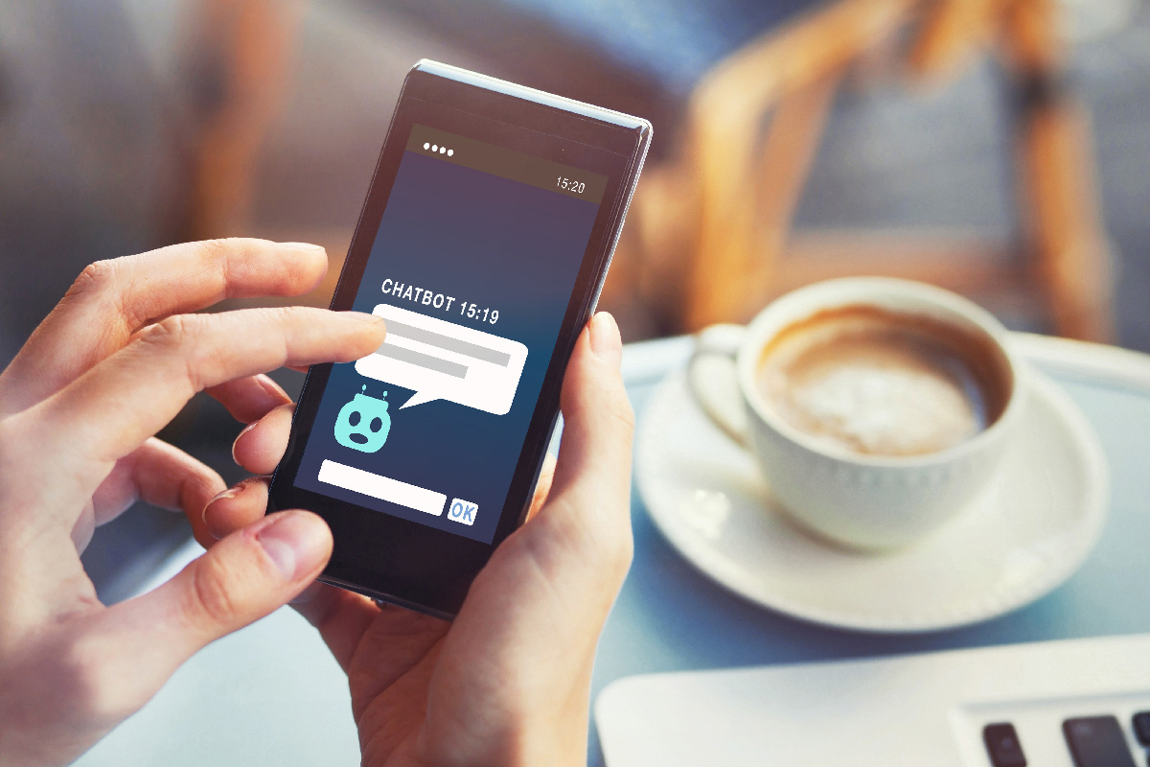
THANK YOU

